Slide 1


Inference Problems in the Linear Regime Lessons from group testing
Matthew Aldridge
University of Leeds, UK
Workshop on Inference Problems: Algorithms and Lower Bounds September 2020

Slide 2
1
Inference problems

Slide 3
Inference problems
There are a large number n of inputs
Inferring all their values takes many (perhaps n) measurements

Slide 4
Inference problems
There are a large number n of inputs
Inferring all their values takes many (perhaps n) measurements
But only a small number k of the inputs are active
Finding the active inputs and inferring their values takes few (perhaps k log n) measurements

Slide 5
Inference problems
There are a large number n of inputs
But only a small number k of the inputs are active
Statistical models with n parameters: Typically we need at least n pieces of data. But if we know all but k of the parameters are zero, we require less data.

Slide 6
Inference problems
There are a large number n of inputs
But only a small number k of the inputs are active
Statistical models with n parameters: Typically we need at least n pieces of data. But if we know all but k of the parameters are zero, we require less data.
Compressed sensing: Typically solving simultaneous linear equations in n variables requires n equations, but if the solution is k-sparse (in some basis) we require fewer.

Slide 7
Inference problems
There are a large number n of inputs
But only a small number k of the inputs are active
Statistical models with n parameters: Typically we need at least n pieces of data. But if we know all but k of the parameters are zero, we require less data.
Compressed sensing: Typically solving simultaneous linear equations in n variables requires n equations, but if the solution is k-sparse (in some basis) we require fewer.
Pooled group testing…

Slide 8
Group testing

Slide 9
Group testing

Slide 10
Group testing

Slide 11
Group testing
Dorfman, 1943

Slide 12
Group testing
Dorfman, 1943

Slide 13
Types of problem
Adaptive look at previous tests before designing the next | Nonadaptive all tests designed in advance

Slide 14
Group testing
n items (soldiers)
k defective items (soldiers with syphilis)
T tests: “Does this group of items contain at least one defective item?” (blood tests)

Slide 15
Main problem
n items
k defective items
T tests
Given n and k, how many tests T do we need
to reliably work out
which items were defective?

Slide 16
Main problem
n items
k defective items
T tests
We can test individually with T = n tests.
If k is small, can we manage with fewer?

Slide 17
M Aldridge, O Johnson and J Scarlett Group Testing: An Information Theory Perspective Foundations and Trends in Communications and Information Theory, 2019
Preprint:
arXiv:1902.06002

Slide 18
Why should I care?

Slide 19
Why should I care?
Applications
Testing soldiers for syphilis
Testing for COVID-19 with limited test capacity
DNA screening
Management of wireless networks
Database management
Data compression
Cybersecurity
Graph learning
The counterfeit coin problem
…

Slide 20
Why should I care?
Applications
Concrete example of more general problems
Sparse inference, p > n statistics
Nonlinear models
Search problems
Inverse problems

Slide 21
Why should I care?
Applications
Concrete example of more general problems
A fun problem in its own right
Probability
Statistics
Computer science
Information theory
Combinatorics

Slide 22
Types of group testing
Adaptive Look at previous tests before designing the next |  | Nonadaptive All tests designed in advance

Slide 23
Types of group testing
Adaptive Look at previous tests before designing the next |  | Nonadaptive All tests designed in advance

Slide 24
Types of group testing
Adaptive Look at previous tests before designing the next |  | Nonadaptive All tests designed in advance
Combinatorial Exactly k defective items Worst-case number of tests |  | Probabilistic Each item defective with prob k/n Typical number of tests

Slide 25
Types of group testing
Adaptive Look at previous tests before designing the next |  | Nonadaptive All tests designed in advance
Combinatorial Exactly k defective items Worst-case number of tests |  | Probabilistic Each item defective with prob k/n Typical number of tests
Very sparse k constant as n → ∞ | Sparse k grows like nª for a < 1 |  | Linear k ~ pn grows linearly with n

Slide 26
Coronavirus in England
England has about 55 million people.
It’s estimated that about 30,000 people currently have COVID-19

Slide 27
Coronavirus in England
England has about 55 million people.
It’s estimated that about 30,000 people currently have COVID-19
Which is the most important calculation?

Slide 28
Coronavirus in England
England has about 55 million people.
It’s estimated that about 30,000 people currently have COVID-19
Which is the most important calculation?
This is 30,000 infected people, but the population is irrelevant

Slide 29
Coronavirus in England
England has about 55 million people.
It’s estimated that about 30,000 people currently have COVID-19
Which is the most important calculation?
This is 30,000 infected people, but the population is irrelevant
The number of infected people is roughly (population)^{0.58}

Slide 30
Coronavirus in England
England has about 55 million people.
It’s estimated that about 30,000 people currently have COVID-19
Which is the most important calculation?
This is 30,000 infected people, but the population is irrelevant
The number of infected people is roughly (population)^{0.58}
The number of infected people is roughly 0.05% of the population

Slide 31
Types of group testing
Adaptive Look at previous tests before designing the next |  | Nonadaptive All tests designed in advance
Combinatorial Exactly k defective items Want to be certain of success |  | Probabilistic Each item defective with prob k/n Average-case number of tests
Very sparse k constant as n → ∞ | Sparse k grows like nª for a < 1

Slide 32
Types of group testing
Adaptive Look at previous tests before designing the next |  | Nonadaptive All tests designed in advance
Combinatorial Exactly k defective items Want to be certain of success |  | Probabilistic Each item defective with prob k/n Average-case number of tests
Very sparse k constant as n → ∞ | Sparse k grows like nª for a < 1 |  | Linear k ~ pn grows linearly with n

Slide 33
Mathematicians like to think that “sparse” means k = o(n).
But consider if k being “small but linear in n” might be more relevant in the real world.

Slide 34
2
Lower
bounds

Slide 35

Lower bound
For successful group testing, we need
$T≥\log_{2}\left(\begin{matrix}n \\ k\end{matrix}\right)$ tests

Slide 36
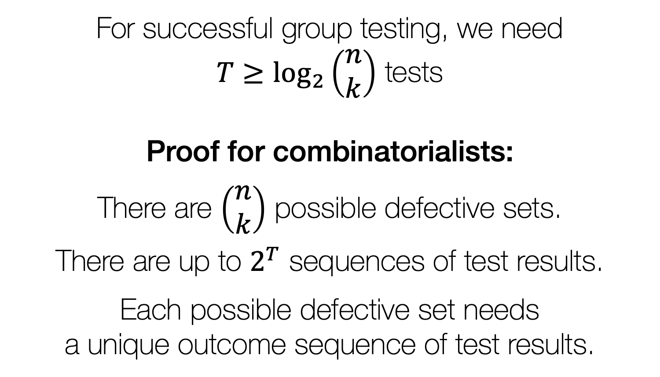
Lower bound
For successful group testing, we need
$T≥\log_{2}\left(\begin{matrix}n \\ k\end{matrix}\right)$ tests
Proof for combinatorialists:
There are $\left(\begin{matrix}n \\ k\end{matrix}\right)$ possible defective sets.
There are up to $2^{T}$ sequences of test results.
Each possible defective set needs a unique outcome sequence of test results.

Slide 37
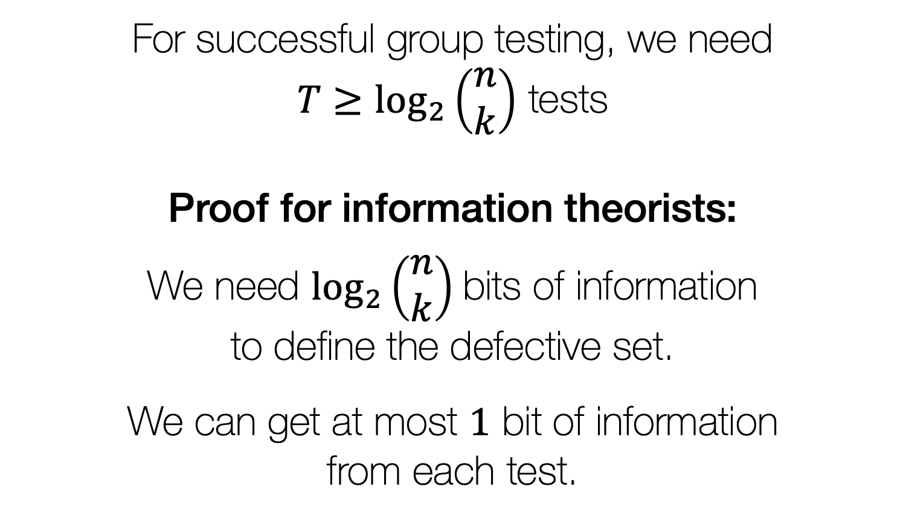
Lower bound
For successful group testing, we need
$T≥\log_{2}\left(\begin{matrix}n \\ k\end{matrix}\right)$ tests
Proof for information theorists:
We need $\log_{2}\left(\begin{matrix}n \\ k\end{matrix}\right)$bits of information to define the defective set.
We can get at most $1$ bit of information from each test.

Slide 38

Lower bound
$$T≥\log_{2}\left(\begin{matrix}n \\ k\end{matrix}\right)$$
Very sparse regime (k constant):
$\log_{2}\left(\begin{matrix}n \\ k\end{matrix}\right)\sim k\log_{2}{n}$

Slide 39
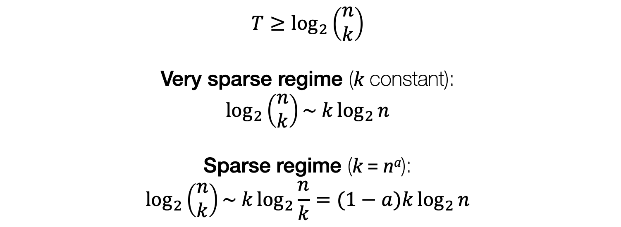
Lower bound
$$T≥\log_{2}\left(\begin{matrix}n \\ k\end{matrix}\right)$$
Very sparse regime (k constant):
$\log_{2}\left(\begin{matrix}n \\ k\end{matrix}\right)\sim k\log_{2}{n}$
Sparse regime (k = nª):
$$\log_{2}\left(\begin{matrix}n \\ k\end{matrix}\right)\sim k\log_{2}{\frac{n}{k}}=(1−a)k\log_{2}{n}$$

Slide 40
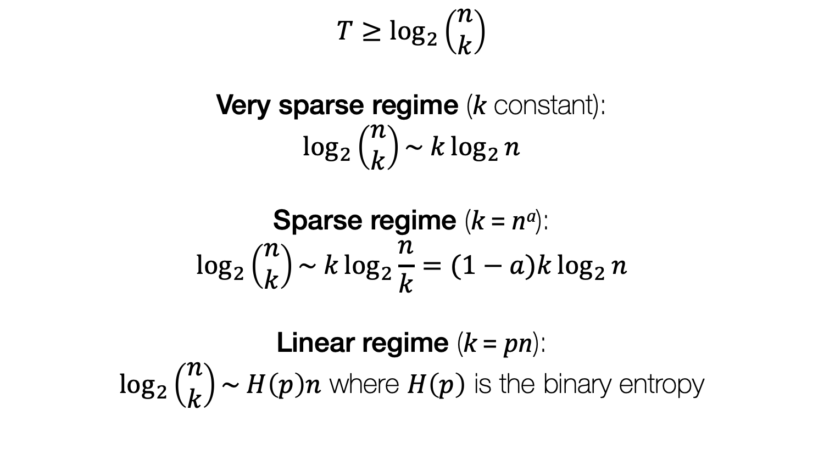
Lower bound
$$T≥\log_{2}\left(\begin{matrix}n \\ k\end{matrix}\right)$$
Very sparse regime (k constant):
$\log_{2}\left(\begin{matrix}n \\ k\end{matrix}\right)\sim k\log_{2}{n}$
Sparse regime (k = nª):
$$\log_{2}\left(\begin{matrix}n \\ k\end{matrix}\right)\sim k\log_{2}{\frac{n}{k}}=(1−a)k\log_{2}{n}$$
Linear regime (k = pn):
$\log_{2}\left(\begin{matrix}n \\ k\end{matrix}\right)\sim H\left(p\right)n$ where $H\left(p\right)$ is the binary entropy

Slide 41
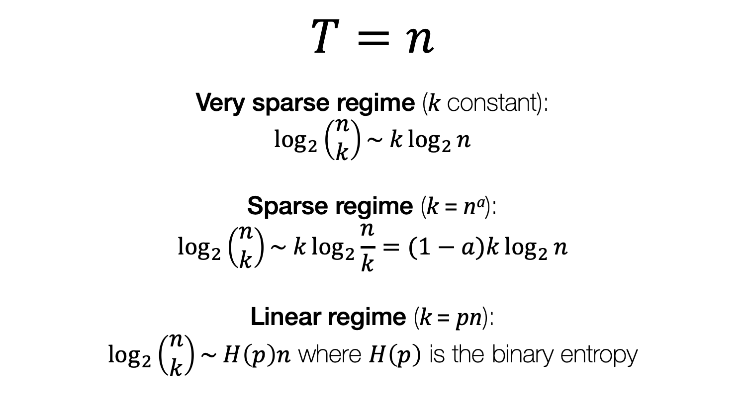
Individual testing
$$T=n$$
Very sparse regime (k constant):
$\log_{2}\left(\begin{matrix}n \\ k\end{matrix}\right)\sim k\log_{2}{n}$
Sparse regime (k = nª):
$$\log_{2}\left(\begin{matrix}n \\ k\end{matrix}\right)\sim k\log_{2}{\frac{n}{k}}=(1−a)k\log_{2}{n}$$
Linear regime (k = pn):
$\log_{2}\left(\begin{matrix}n \\ k\end{matrix}\right)\sim H\left(p\right)n$ where $H\left(p\right)$ is the binary entropy

Slide 42
In the linear regime, naïve “sparsity-ignorant” algorithms can be competitive or even optimal.
.

Slide 43
In the linear regime, naïve “sparsity-ignorant” algorithms can be competitive or even optimal.
In the linear regime, order-optimal behaviour can be obvious; try to find the constants.

Slide 44
3
Algorithms for adaptive group testing

Slide 45
Binary splitting (Sobel & Groll, 1959)
Keep splitting the set in half,
keeping a half that has a defective item in it

Slide 46
Binary splitting

Slide 47
Binary splitting

Slide 48
Binary splitting

Slide 49
Binary splitting

Slide 50
Binary splitting

Slide 51
Binary splitting

Slide 52
Binary splitting

Slide 53
Binary splitting

Slide 54
Binary splitting

Slide 55
Binary splitting

Slide 56
Binary splitting

Slide 57
Binary splitting

Slide 58
Binary splitting

Slide 59
Binary splitting

Slide 60
Simple binary splitting (Sobel & Groll, 1959)
For the combinatorial (k known) model:
Repeat k times:
Use binary splitting to find a defective. Remove it.

Slide 61
Simple binary splitting (Sobel & Groll, 1959)
For the probabilistic (k unknown) model:
1) Test the whole set.
If the test is positive: Use binary splitting to find a defective. Remove it, and return to 1).
If the test is negative: All items are nondefective. Halt.

Slide 62

Simple binary splitting
Theorem: The simple binary splitting algorithm requires
$${k log}_{2}{n}+O(k)$$
tests.

Slide 63
Simple binary splitting
Theorem: The simple binary splitting algorithm requires
$${k log}_{2}{n}+O(k)$$
tests.
k rounds of binary splitting a set of size n
“book-keeping” tests and rounding errors

Slide 64
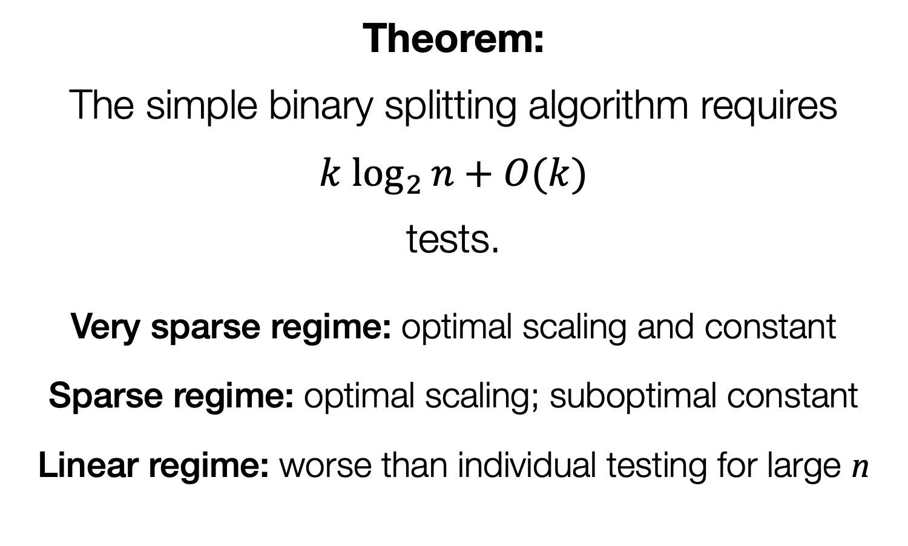
Simple binary splitting
Theorem: The simple binary splitting algorithm requires
$${k log}_{2}{n}+O(k)$$
tests.
Very sparse regime: optimal scaling and constant
Sparse regime: optimal scaling; suboptimal constant
Linear regime: worse than individual testing for large n

Slide 65
Generalized binary splitting (Hwang, 1972)
In the sparse and linear regimes, we waste too much time at the beginning of each stage testing sets that are almost certain to contain a defective item

Slide 66
Generalized binary splitting (Hwang, 1972)
Split into k sets of size n/k For each set do simple binary splitting:
1) Test the whole set.
If the test is positive: Use binary splitting to find a defective. Remove it, and return to 1).
If the test is negative: All items are nondefective. Halt.

Slide 67
Generalized binary splitting (Hwang, 1972)
On average, one defective each
Split into k sets of size n/k For each set do simple binary splitting:
1) Test the whole set.
If the test is positive: Use binary splitting to find a defective. Remove it, and return to 1).
If the test is negative: All items are nondefective. Halt.

Slide 68
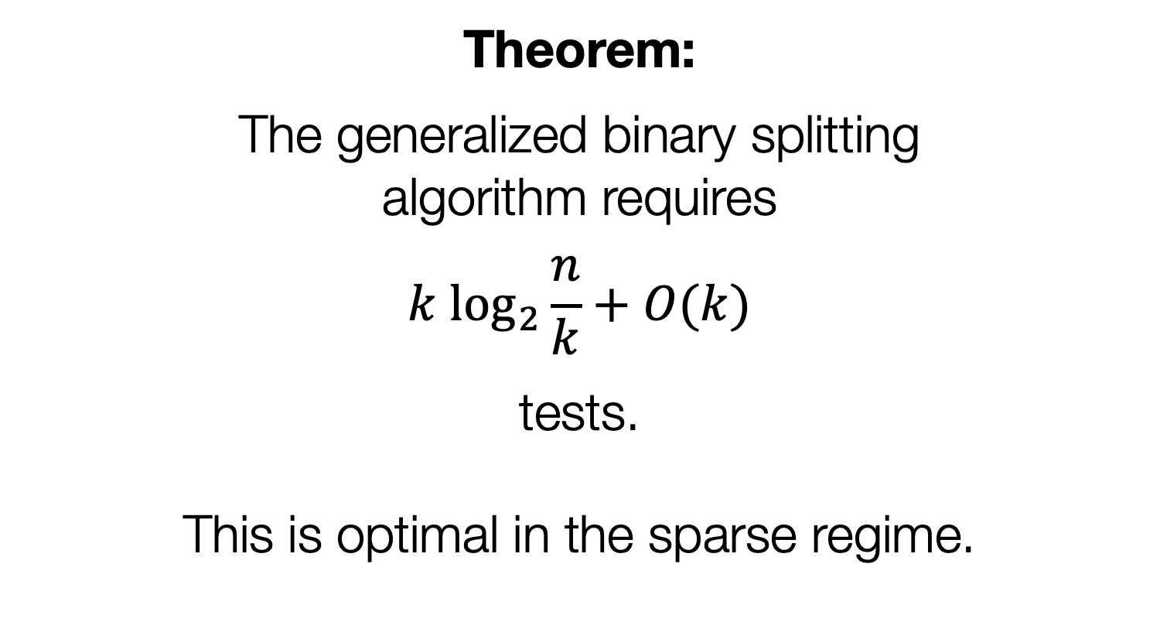
Generalized binary splitting (Hwang, 1972; Baldassini–Johnson–Aldridge, 2013)
Theorem: The generalized binary splitting algorithm requires
$${k log}_{2}{\frac{n}{k}}+O(k)$$
tests.
This is optimal in the sparse regime.

Slide 69
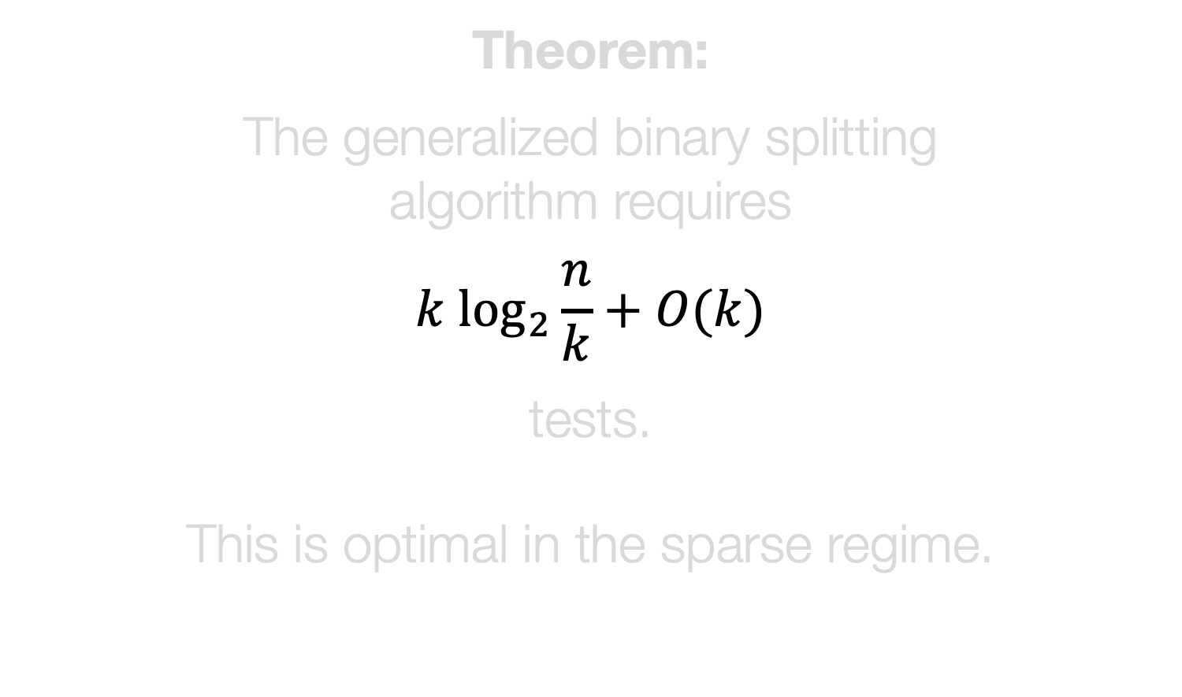
Generalized binary splitting (Hwang, 1972; Baldassini–Johnson–Aldridge, 2013)
Theorem: The generalized binary splitting algorithm requires
$${k log}_{2}{\frac{n}{k}}+O(k)$$
tests.
This is optimal in the sparse regime.
k rounds of binary splitting a set of size n/k
“book-keeping” tests and rounding errors

Slide 70
Don’t waste effort on measurements if you think you know what the answer will be.

Slide 71
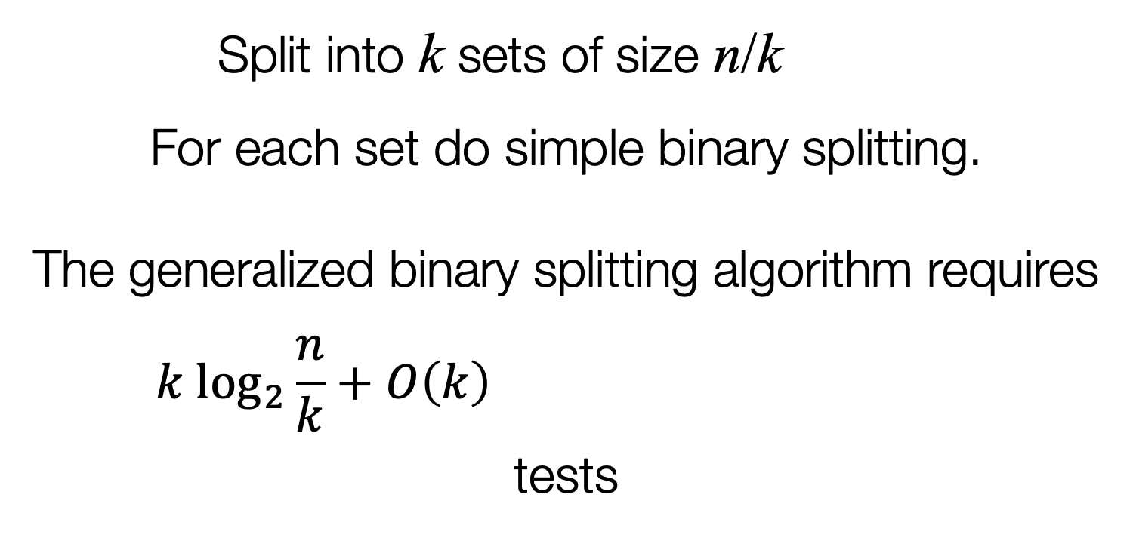
Linear regime
Split into k sets of size n/k = 1/p For each set do simple binary splitting.
The generalized binary splitting algorithm requires
$${k log}_{2}{\frac{n}{k}}+O\left(k\right)=\left(p\log_{2}{\frac{1}{p}}\right)n+O(n)$$
tests

Slide 72
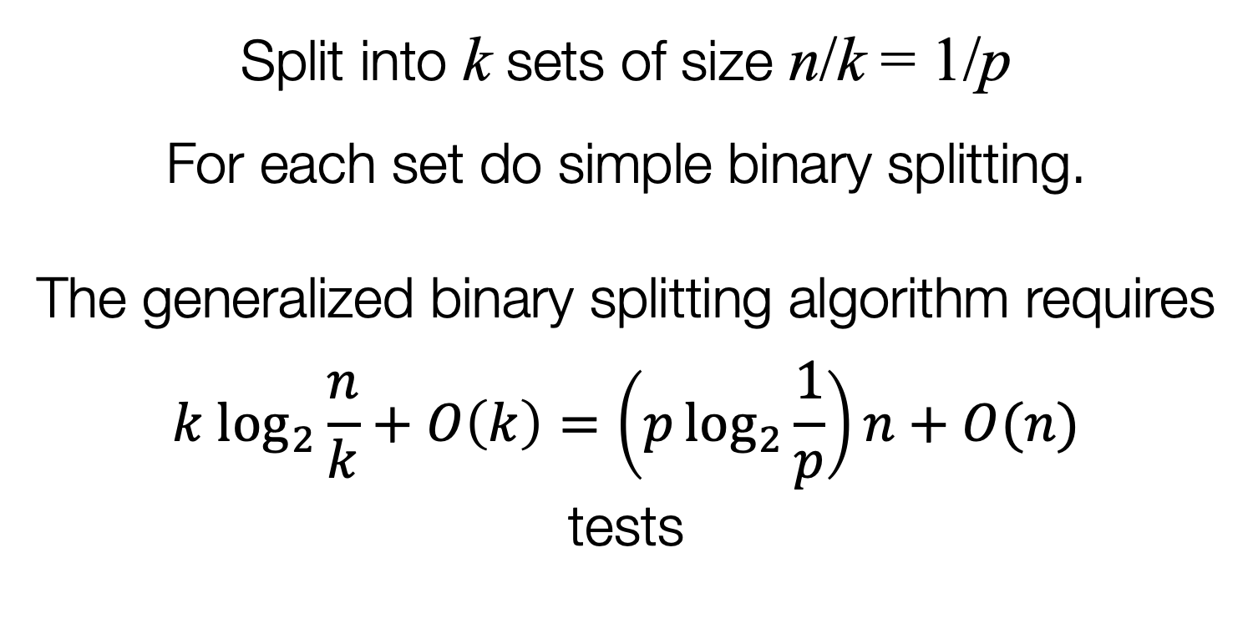
Linear regime
Split into k sets of size n/k = 1/p For each set do simple binary splitting.
The generalized binary splitting algorithm requires
$${k log}_{2}{\frac{n}{k}}+O\left(k\right)=\left(p\log_{2}{\frac{1}{p}}\right)n+O(n)$$
tests

Slide 73
Linear regime
Might not be an integer
Split into k sets of size n/k = 1/p For each set do simple binary splitting.
The generalized binary splitting algorithm requires
$${k log}_{2}{\frac{n}{k}}+O\left(k\right)=\left(p\log_{2}{\frac{1}{p}}\right)n+O(n)$$
tests

Slide 74
Linear regime
Might not be an integer
Split into k sets of size n/k = 1/p For each set do simple binary splitting.
The generalized binary splitting algorithm requires
$${k log}_{2}{\frac{n}{k}}+O\left(k\right)=\left(p\log_{2}{\frac{1}{p}}\right)n+O(n)$$
tests
Need to be careful with “error term”

Slide 75
Linear regime
Might not be an integer
Split into k sets of size n/k = 1/p For each set do simple binary splitting.
The generalized binary splitting algorithm requires
$${k log}_{2}{\frac{n}{k}}+O\left(k\right)=\left(p\log_{2}{\frac{1}{p}}\right)n+O(n)$$
tests
Suboptimal compared to counting bound
Need to be careful with “error term”

Slide 76
Instead we’ll try…
1) Pick a set of size m = 2^{s}.
2) Test the set.
If the test is positive: Use binary splitting to find a defective. Return to 1).
If the test is negative: All items in the set are nondefective. Return to 1).
(Parameter to be chosen later)

Slide 77
Instead we’ll try…
1) Pick a set of size m = 2^{s}.
2) Test the set.
If the test is positive: Use binary splitting to find a defective. Return to 1).
If the test is negative: All items in the set are nondefective. Return to 1).
m = 1: Individual testing
m = 2: Fischer–Klasner–Wegenera, 1999

Slide 78
Combinatorial testing
At each run through the loop we find:
m = 2^{s} nondefectives
in 1 test
or
1 defective in 1 + log₂ m = s + 1 tests

Slide 79
Binary splitting

Slide 80
Binary splitting

Slide 81
Combinatorial testing
At each run through the loop we find:
m = 2^{s} nondefectives
in 1 test
or
1 defective 1 = 2^{s} – 1 nondefectives in 1 + log₂ m = s + 1 tests

Slide 82
Combinatorial testing
At each run through the loop we find:
m = 2^{s} nondefectives
in 1 test
or
1 defective and up to m – 1 = 2^{s} – 1 nondefectives in 1 + log₂ m = s + 1 tests

Slide 83
Combinatorial testing
At each run through the loop we find:
m = 2^{s} nondefectives
in 1 test
or
1 defective and up to m – 1 = 2^{s} – 1 nondefectives in 1 + log₂ m = s + 1 tests
Worst-case analysis:
Assume we’re unlucky

Slide 84
Combinatorial testing
Each of the k defectives requires 1 + log₂ m = s + 1 tests.
Each set of m = 2^{s} nondefectives
requires 1 test.

Slide 85
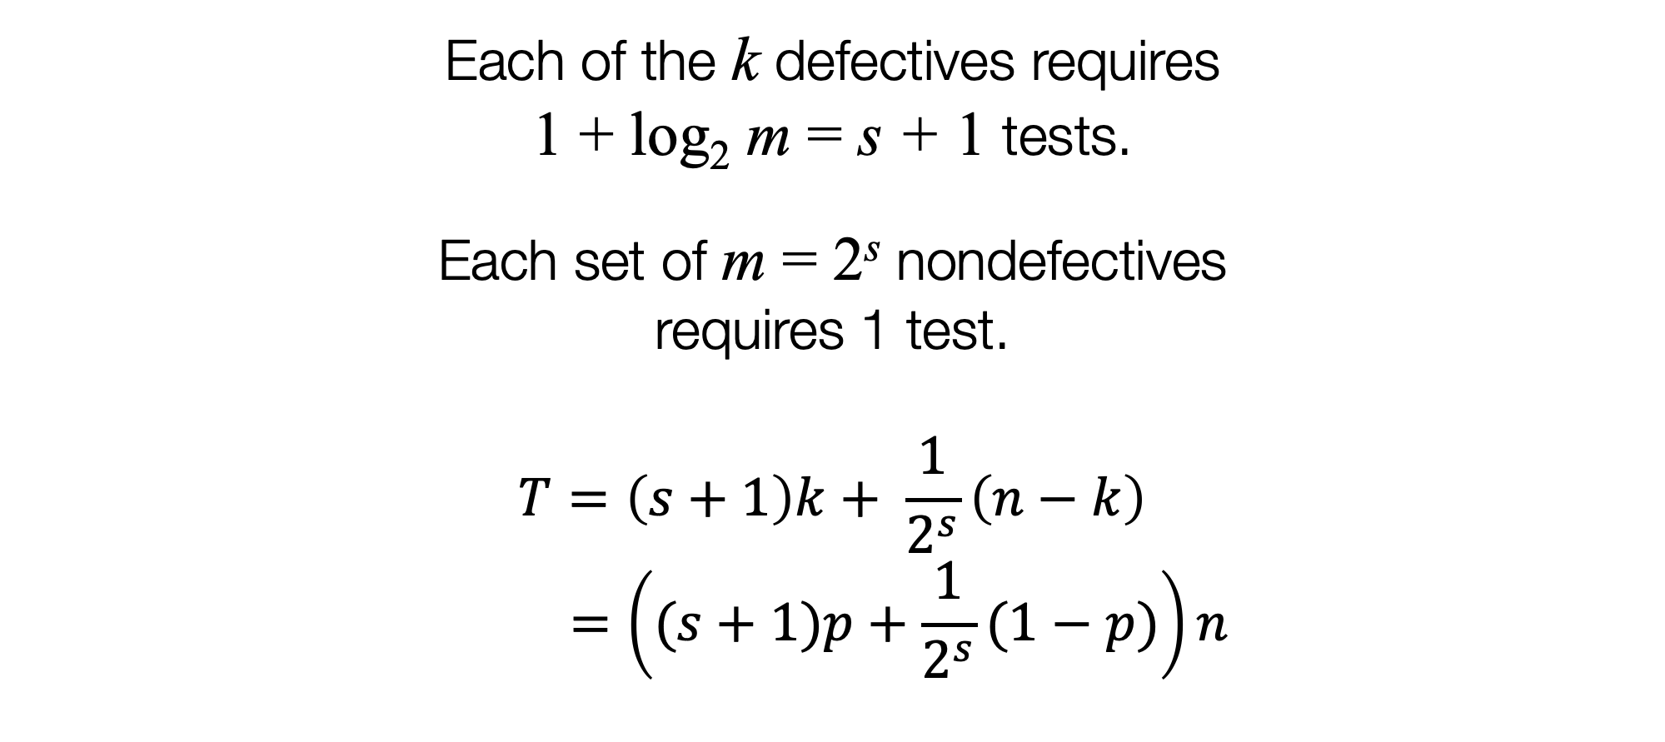
Combinatorial testing
Each of the k defectives requires 1 + log₂ m = s + 1 tests.
Each set of m = 2^{s} nondefectives
requires 1 test.
$$T=\left(s+1\right)k+ \frac{1}{2^{s}}\left(n−k\right)$$
$$=\left((s+1)p+\frac{1}{2^{s}}(1−p)\right)n$$

Slide 87
Beats individual testing for p < 1/3

Slide 88
Open problem
Prove that individual testing is optimal for p ≥ 1/3 for combinatorial testing.
(Conjectured by Hu–Hwang–Wang, 1981)

Slide 89
Probabilistic testing
At each run through the loop we find:
m = 2^{s} nondefectives
in 1 test
or
1 defective and up to m – 1 = 2^{s} – 1 nondefectives in 1 + log₂ m = s + 1 tests

Slide 90
Probabilistic testing
At each run through the loop we find:
m = 2ª nondefectives
in 1 test
or
1 defective and up to m – 1 = 2ª – 1 nondefectives in 1 + log₂ m = a + 1 tests
How well do we do on average?

Slide 91

The algorithm
Aldridge (2019) shows that for q = 1 – p:
Average tests per loop:
$$F ={ q}^{m} × 1 + (1−q^{m})(1+\log_{2}{m})$$

Slide 92
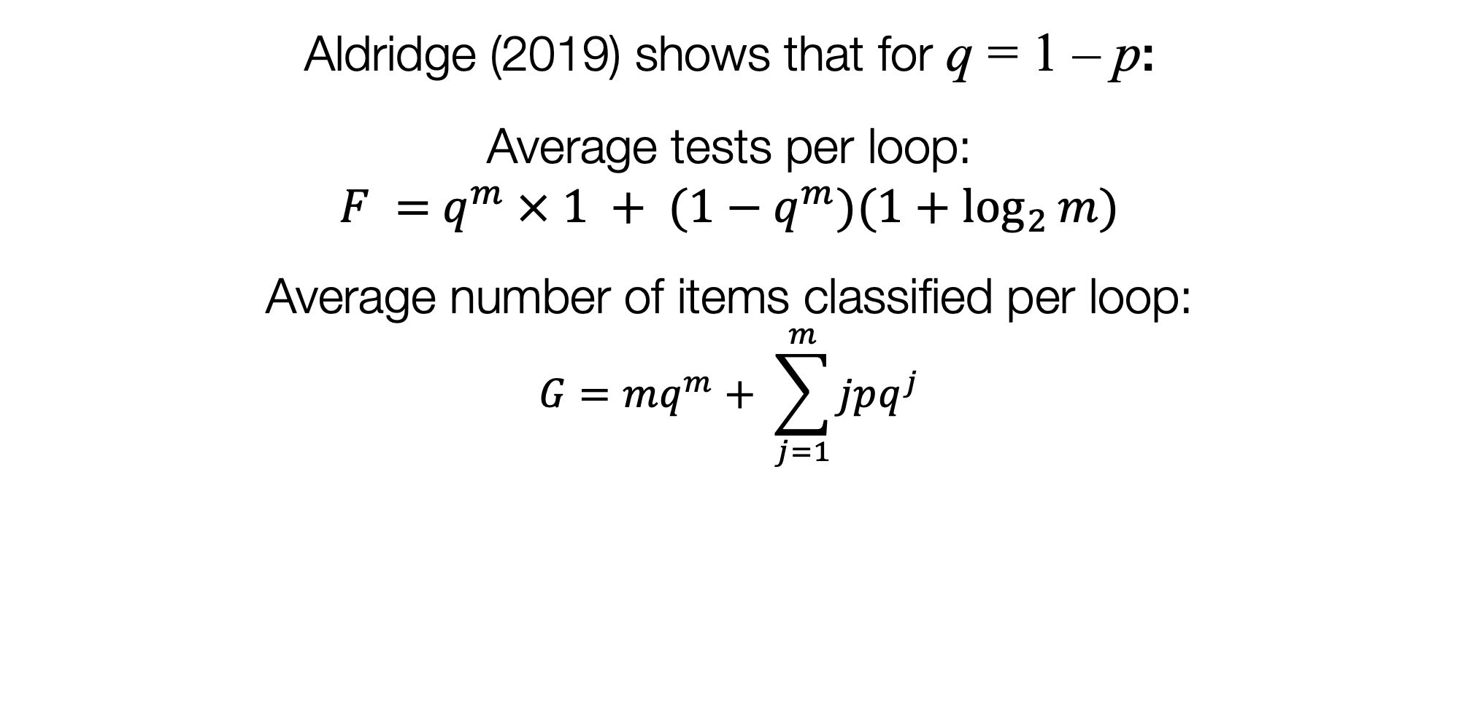
The algorithm
Aldridge (2019) shows that for q = 1 – p:
Average tests per loop:
$$F ={ q}^{m} × 1 + (1−q^{m})(1+\log_{2}{m})$$
Average number of items classified per loop:
$$G=mq^{m}+ \sum_{j=1}^{m}{jpq^{j}}$$

Slide 93
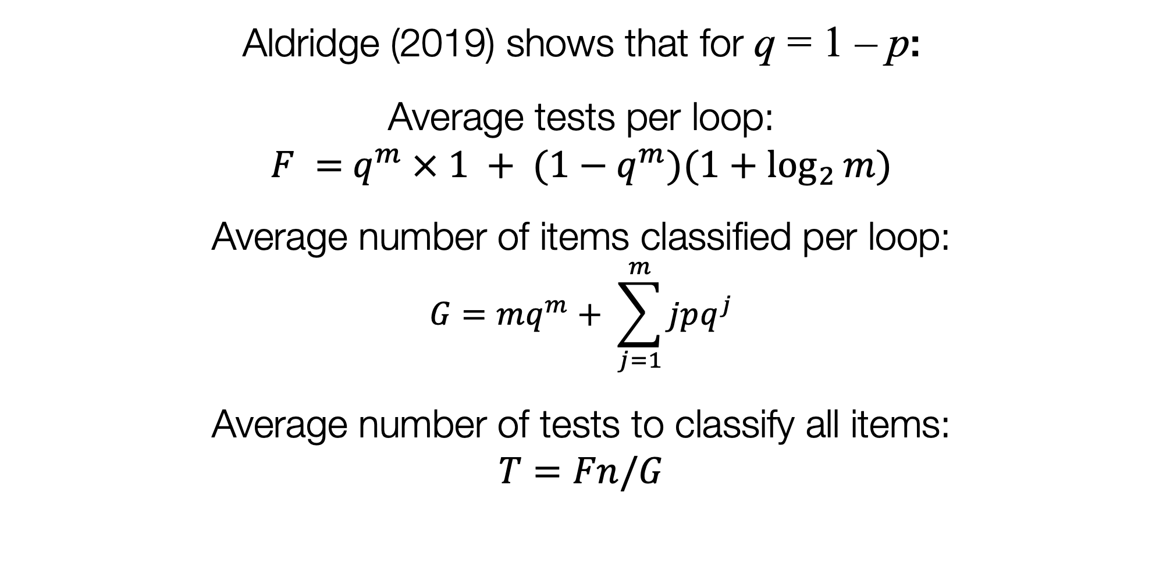
The algorithm
Aldridge (2019) shows that for q = 1 – p:
Average tests per loop:
$$F ={ q}^{m} × 1 + (1−q^{m})(1+\log_{2}{m})$$
Average number of items classified per loop:
$$G=mq^{m}+ \sum_{j=1}^{m}{jpq^{j}}$$
Average number of tests to classify all items:
$T=Fn/G$

Slide 95
Beats individual testing for p < 0.382 which is optimal (Ungar, 1960)

Slide 96
Rate
It can be useful to look at the “rate”
Rate = bits learned per test = n H(p)/T
ratio of lower bound to actual number of tests

Slide 98
Improvement
We can sometimes do slightly better for probabilistic testing if we allow the set size m to not be a power of 2.
Use a Huffman tree for uniform probabilities to organize the binary splitting.
(Zaman–Pippenger, 2016; Aldridge 2019)

Slide 100
Open problem
Improve on these algorithms, or show they are optimal.

Slide 101
Adaptive testing in the linear regime
We need to take greater care with “error terms”.
We need to take care that parameters that need to be integers are integers.
There can be a bigger difference between average-case and worst-case behaviour.
Naïve algorithms can be optimal: try to find out when this is.

Slide 102
4
Nonadaptive group testing

Slide 103
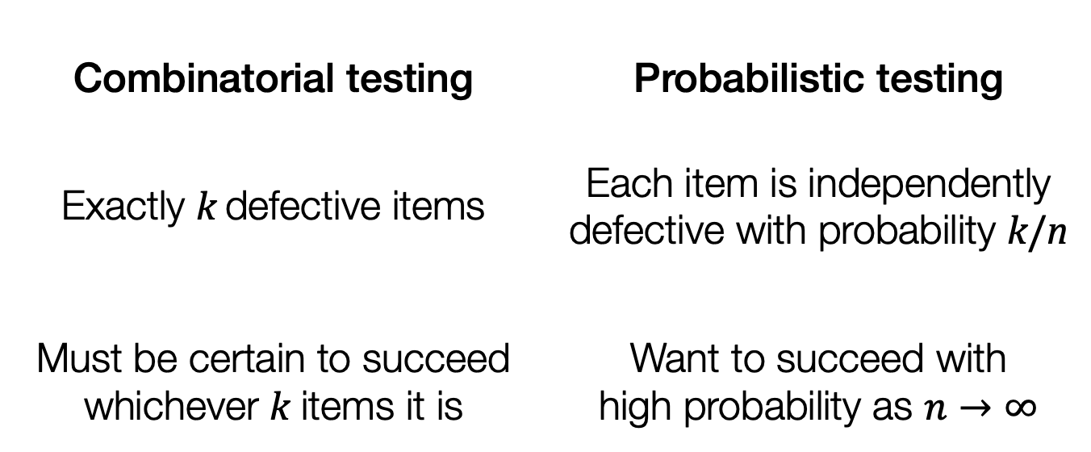
Nonadaptive testing
The entire test design is fixed before we start then all tests carried out in parallel
Combinatorial testing | Probabilistic testing
Exactly k defective items | Each item is independently defective with probability k/n
Must be certain to succeed whichever k items it is | Want to succeed with high probability as $n→∞$

Slide 104
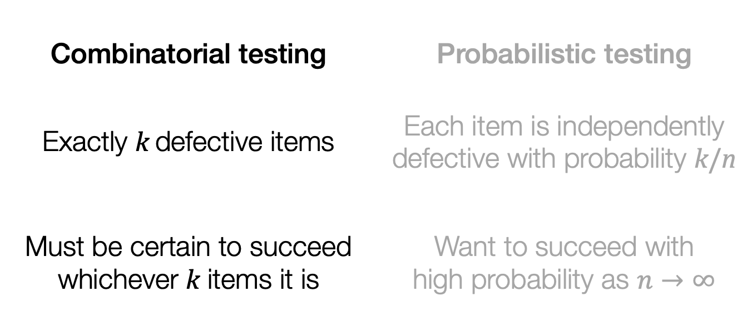
Nonadaptive testing
The entire test design is fixed before we start then all tests carried out in parallel
Combinatorial testing | Probabilistic testing
Exactly k defective items | Each item is independently defective with probability k/n
Must be certain to succeed whichever k items it is | Want to succeed with high probability as $n→∞$

Slide 105
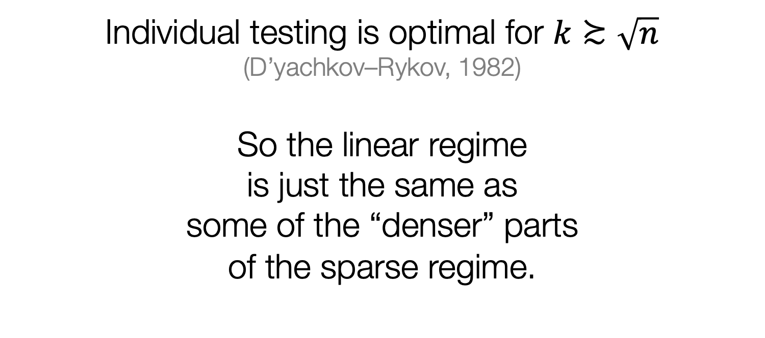
Combinatorial nonadaptive
Individual testing is optimal for $k≿\sqrt{n}$
(D’yachkov–Rykov, 1982)
So the linear regime is just the same as some of the “denser” parts of the sparse regime.

Slide 106
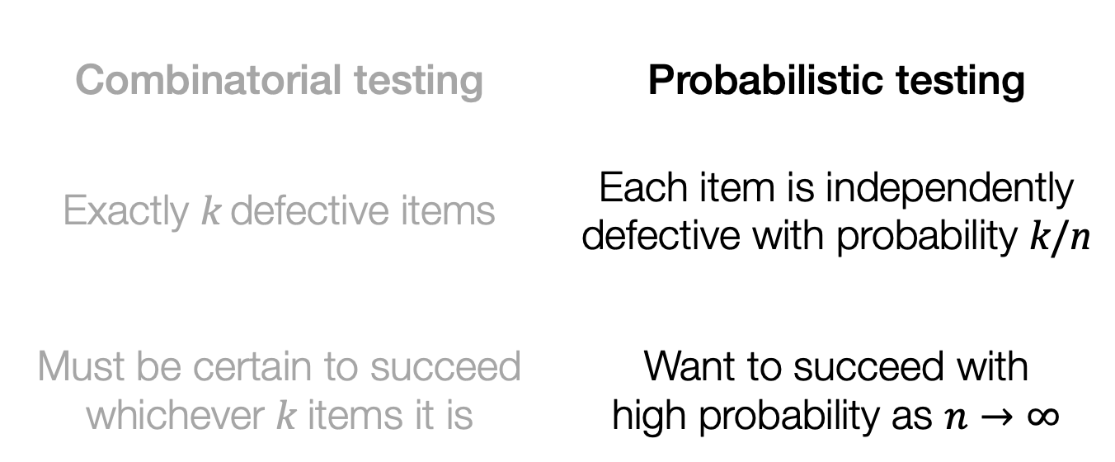
Nonadaptive testing
The entire test design is fixed before we start then all tests carried out in parallel
Combinatorial testing | Probabilistic testing
Exactly k defective items | Each item is independently defective with probability k/n
Must be certain to succeed whichever k items it is | Want to succeed with high probability as $n→∞$

Slide 107
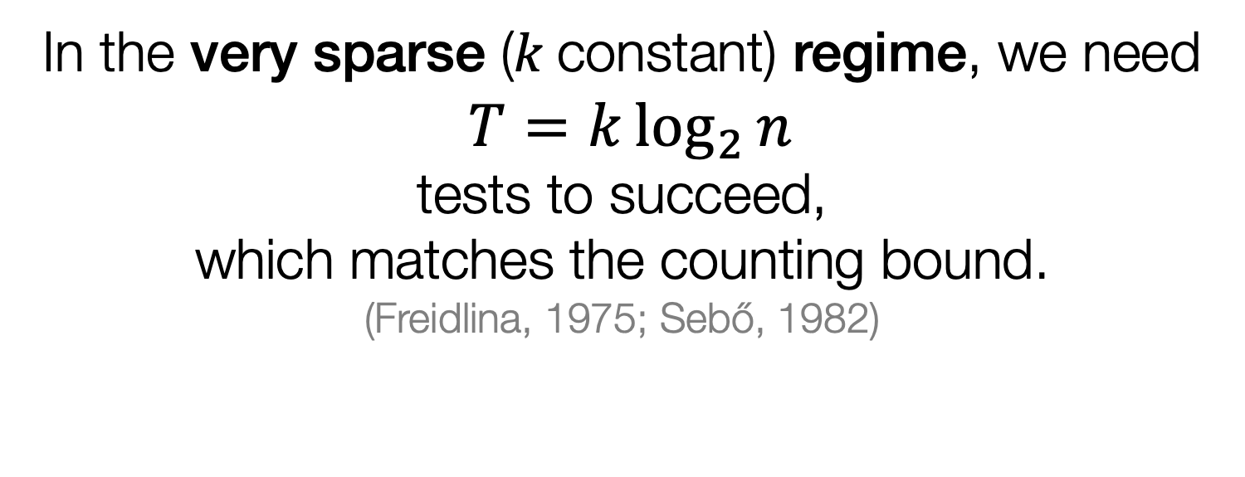
Probabilistic nonadaptive
In the very sparse (k constant) regime, we need
$T=k\log_{2}{n}$ tests to succeed, which matches the counting bound.
(Freidlina, 1975; Sebő, 1982)

Slide 108
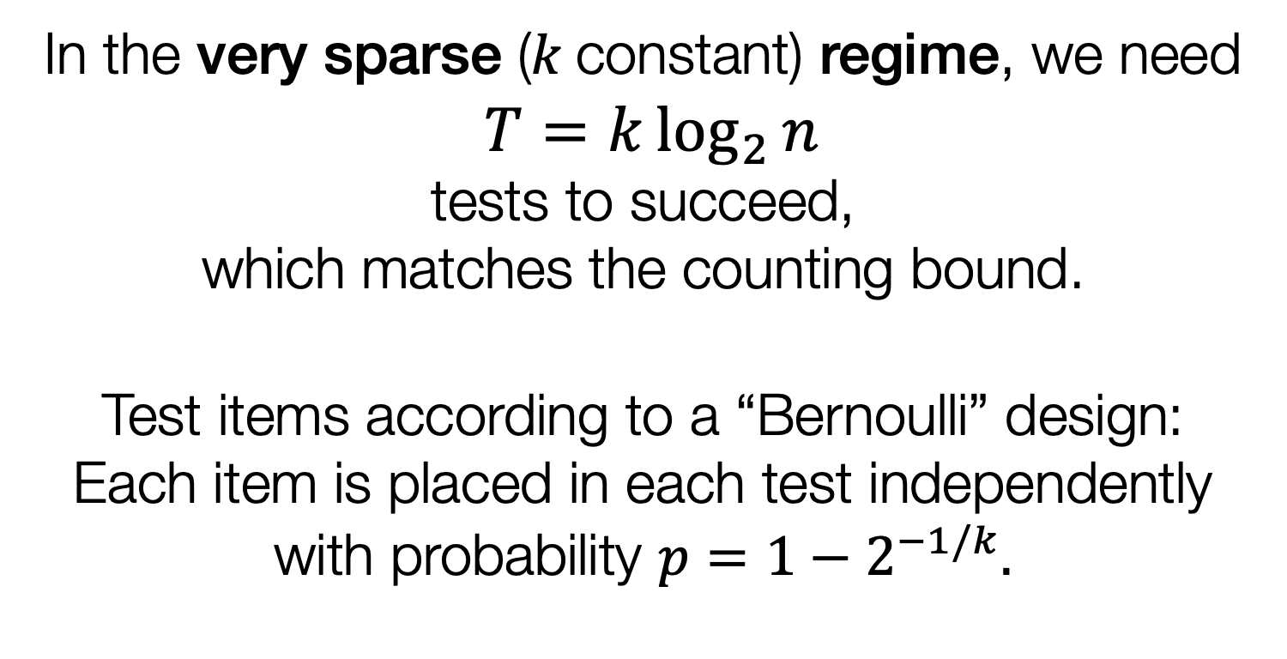
Probabilistic nonadaptive
In the very sparse (k constant) regime, we need
$T=k\log_{2}{n}$ tests to succeed, which matches the counting bound.
Test items according to a “Bernoulli” design:
Each item is placed in each test independently with probability $p=1−2^{−1/k}.$

Slide 109
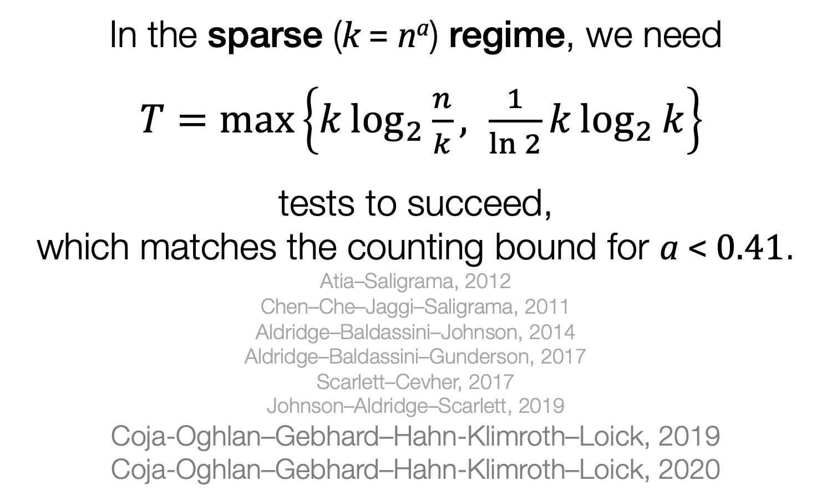
Probabilistic nonadaptive
In the sparse (k = nª) regime, we need
$T=\text{max}\left\{k\log_{2}{\frac{n}{k}, \frac{1}{\ln{2}}}k\log_{2}{k}\right\}$
tests to succeed, which matches the counting bound for a < 0.41.
Atia–Saligrama, 2012
Chen–Che–Jaggi–Saligrama, 2011 Aldridge–Baldassini–Johnson, 2014 Aldridge–Baldassini–Gunderson, 2017 Scarlett–Cevher, 2017
Johnson–Aldridge–Scarlett, 2019
Coja-Oghlan–Gebhard–Hahn-Klimroth–Loick, 2019
Coja-Oghlan–Gebhard–Hahn-Klimroth–Loick, 2020

Slide 110
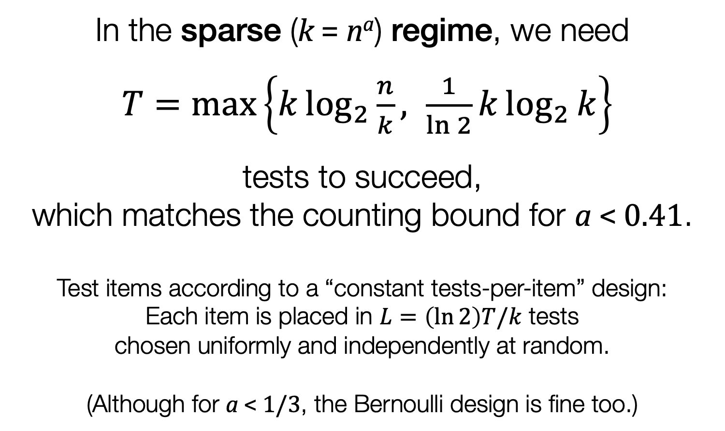
Probabilistic nonadaptive
In the sparse (k = nª) regime, we need
$T=\text{max}\left\{k\log_{2}{\frac{n}{k}, \frac{1}{\ln{2}}}k\log_{2}{k}\right\}$
tests to succeed, which matches the counting bound for a < 0.41.
Test items according to a “constant tests-per-item” design:
Each item is placed in $L=\left(\ln{2}\right)T/k$ tests chosen uniformly and independently at random.
(Although for a < 1/3, the Bernoulli design is fine too.)

Slide 111
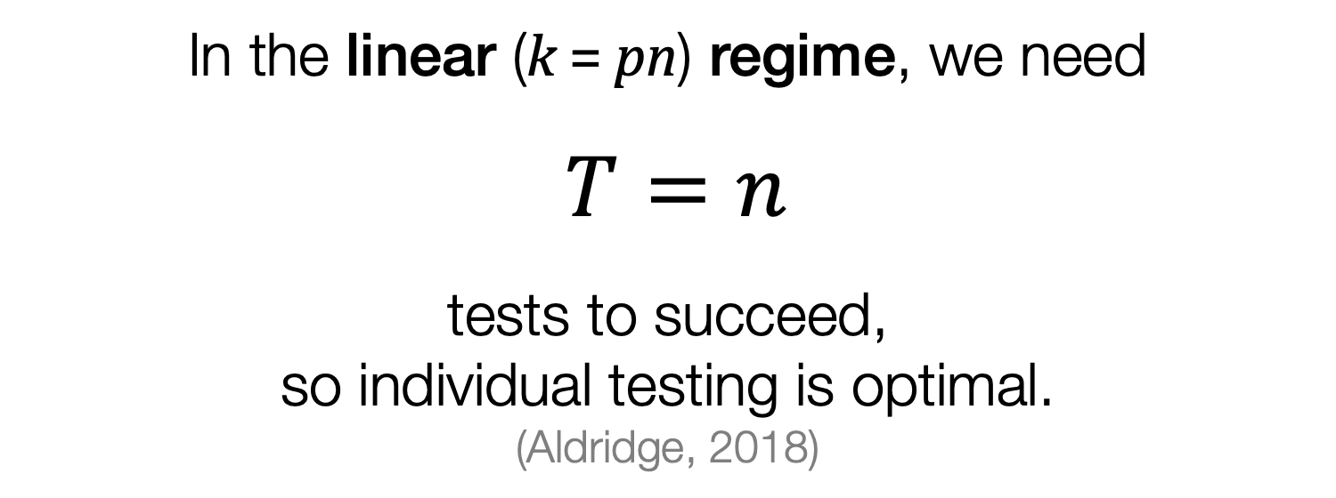
Probabilistic nonadaptive
In the linear (k = pn) regime, we need
$T=n$
tests to succeed, so individual testing is optimal.
(Aldridge, 2018)

Slide 112
Probabilistic nonadaptive
Idea of the proof:
Supposed an item is “hidden”: every test that item is in contains a(nother) defective item.
We can’t be sure whether the item is defective or nondefective.

Slide 113
Probabilistic nonadaptive
Idea of the proof:
Supposed an item is “hidden”: every test that item is in contains a(nother) defective item.
We can’t be sure whether the item is defective or nondefective.
In the very sparse or sparse regimes, we’re safe to guess it’s nondefective.

Slide 114
Probabilistic nonadaptive
Idea of the proof:
Supposed an item is “hidden”: every test that item is in contains a(nother) defective item.
We can’t be sure whether the item is defective or nondefective.
In the very sparse or sparse regimes, we’re safe to guess it’s nondefective.
But in the linear regime, we might guess wrongly.

Slide 115
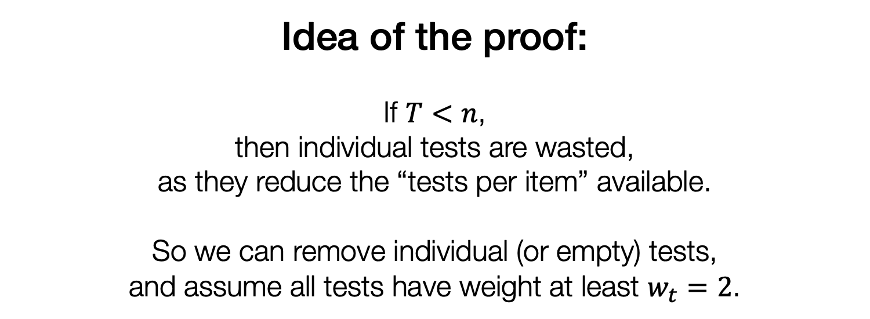
Probabilistic nonadaptive
Idea of the proof:
If $T<n$, then individual tests are wasted, as they reduce the “tests per item” available.
So we can remove individual (or empty) tests, and assume all tests have weight at least $w_{t}=2$.

Slide 116
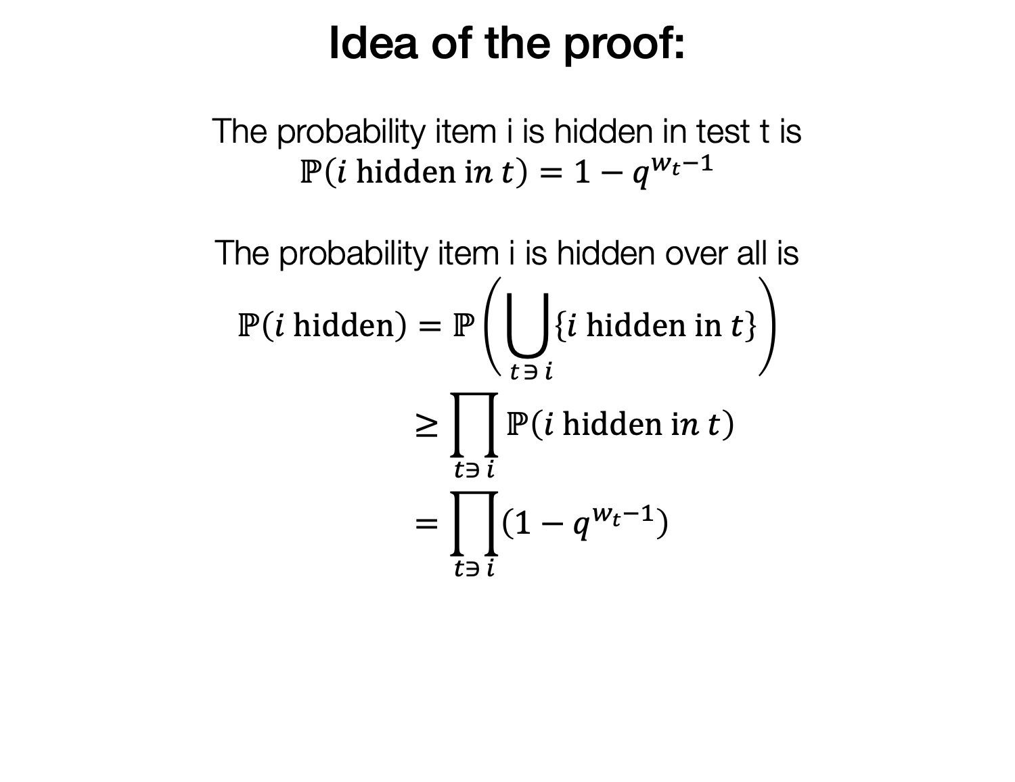
Probabilistic nonadaptive
Idea of the proof:
The probability item i is hidden in test t is
$$ℙ\left(i \text{hidden} \text{i}n t\right)=1−q^{w_{t}−1}$$
The probability item i is hidden over all is
$$ℙ\left(i \text{hidden}\right)=ℙ\left(\bigcup_{ t∋ i}{\left\{i \text{hidden} \text{in} t\right\}}\right) \\ ≥\prod_{t∋ i}{ℙ\left(i \text{hidden} \text{i}n t\right)} \\ =\prod_{t∋ i}{\left(1−q^{w_{t}−1}\right)}$$

Slide 117
Probabilistic nonadaptive
Idea of the proof:
The probability item i is hidden in test t is
$$ℙ\left(i \text{hidden} \text{i}n t\right)=1−q^{w_{t}−1}$$
The probability item i is hidden over all is
$$ℙ\left(i \text{hidden}\right)=ℙ\left(\bigcup_{ t∋ i}{\left\{i \text{hidden} \text{in} t\right\}}\right) \\ ≥\prod_{t∋ i}{ℙ\left(i \text{hidden} \text{i}n t\right)} \\ =\prod_{t∋ i}{\left(1−q^{w_{t}−1}\right)}$$
“Positively correlated”
FKG inequality

Slide 118
Probabilistic nonadaptive
Idea of the proof:
The probability item i is hidden in test t is
$$ℙ\left(i \text{hidden} \text{i}n t\right)=1−q^{w_{t}−1}$$
The probability item i is hidden over all is
$$ℙ\left(i \text{hidden}\right)=ℙ\left(\bigcup_{ t∋ i}{\left\{i \text{hidden} \text{in} t\right\}}\right) \\ ≥\prod_{t∋ i}{ℙ\left(i \text{hidden} \text{i}n t\right)} \\ =\prod_{t∋ i}{\left(1−q^{w_{t}−1}\right)}$$
“Positively correlated”
FKG inequality

Slide 119
Probabilistic nonadaptive
Idea of the proof:
Check that the probability an item is hidden averaged over the item i is bounded away from 0.
Then there’s some item with positive probability of being hidden.
Then there’s a positive probability we guess wrongly whether or not it’s defective.

Slide 120
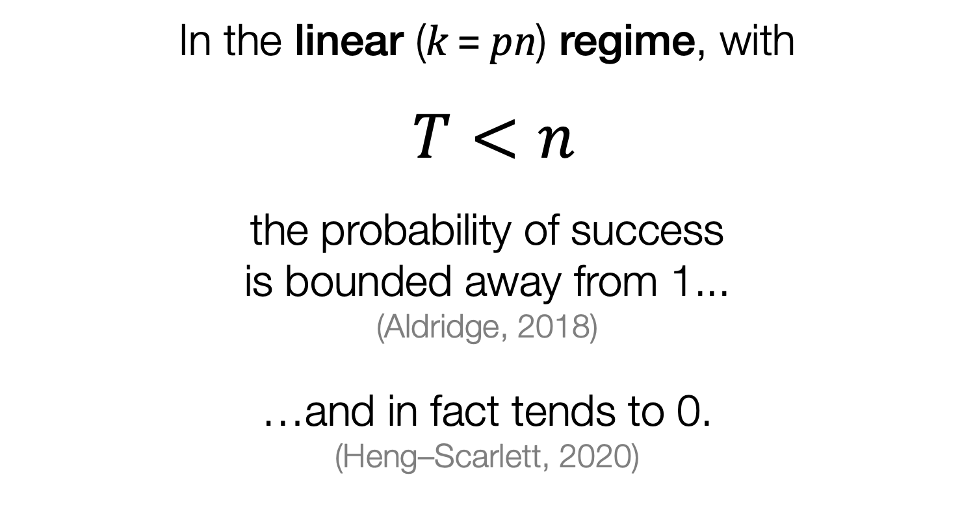
Probabilistic nonadaptive
In the linear (k = pn) regime, with
$T<n$
the probability of success is bounded away from 1...
(Aldridge, 2018)
…and in fact tends to 0.
(Heng–Scarlett, 2020)

Slide 121
Nonadaptive inference in the linear regime
Naïve algorithms can be optimal.
This is because we can’t just assume an input is non-active if we lack evidence.

Slide 122
Probabilistic nonadaptive
This doesn’t mean that nonadaptive group testing ideas are not useful in the linear regime.
We can find many defective and nondefective items in fewer than n tests
(just not all of them)
(Heng–Scarlett, 2020)

Slide 123
5
In closing…

Slide 124
Things I didn’t talk about
Group testing with noise
where the test results are sometimes wrong
Group testing with two (or more) stages between adaptive and nonadaptive
Quantitative group testing:
We have a (possibly imperfect) measure of how many defective items are in the test

Slide 125
M Aldridge, O Johnson and J Scarlett Group Testing: An Information Theory Perspective Foundations and Trends in Communications and Information Theory, 2019
Preprint:
arXiv:1902.06002

Slide 126
Conclusions
Consider if the linear regime might be important for your inference problems.
Naïve sparsity-unaware algorithms (like individual testing) can be optimal.
Order-optimality is good, but look out for constants too. “Error terms” often need more care.

